Slide 1


Internal Audit & Executive Summary
Comprehensive Review: Q3 2026.

Slide 2


1. Introduction & Background
Context of the Review
In accordance with the 2026 Annual Audit Plan, Internal Audit has initiated a comprehensive review of CJSJ Ltd, a key player in the manufacturing sector.
Our audit focuses on evaluating the robustness of CJSJ Ltd's core manufacturing operations, supply chain management, and corresponding financial controls.
The primary objective is to provide independent assurance to the Board regarding the effectiveness of the risk management framework, specifically targeting production efficiency and operational resilience.

Slide 3




2. Audit Scope
Review Period
Testing procedures were conducted on transactions, access logs, and operational activities occurring between January 1, 2026, and September 30, 2026.
In-Scope Areas
Procure to Pay
Order to Cash
Inventory Management
Scrap Management
Quality Management
Taxation
Cyber Security/ITGC

Slide 4


3. Approach & Methodology
Risk Assessment: Conducted preliminary risk scoring based on financial materiality and operational criticality.
Process Walkthroughs: Interviewed process owners to document current-state workflows and identify key control points.
Sample Testing: Applied statistical sampling to test the operating effectiveness of 45 distinct controls over a 9-month period.
Evaluation: Assessed identified control gaps against the COSO framework and evaluated existing compensating controls.

Slide 5



4. Executive Summary
Based on the results of our testing, the overall control environment is rated as "Needs Improvement".
While foundational financial and operational controls are well-designed and operating effectively, significant deficiencies were identified in IT user access management and vendor onboarding processes.
Management has proactively acknowledged these findings and has committed resources to execute a robust remediation plan by the end of Q4.

Slide 6
Summary of Key Findings

Slide 7
Risk Distribution Profile

Slide 8
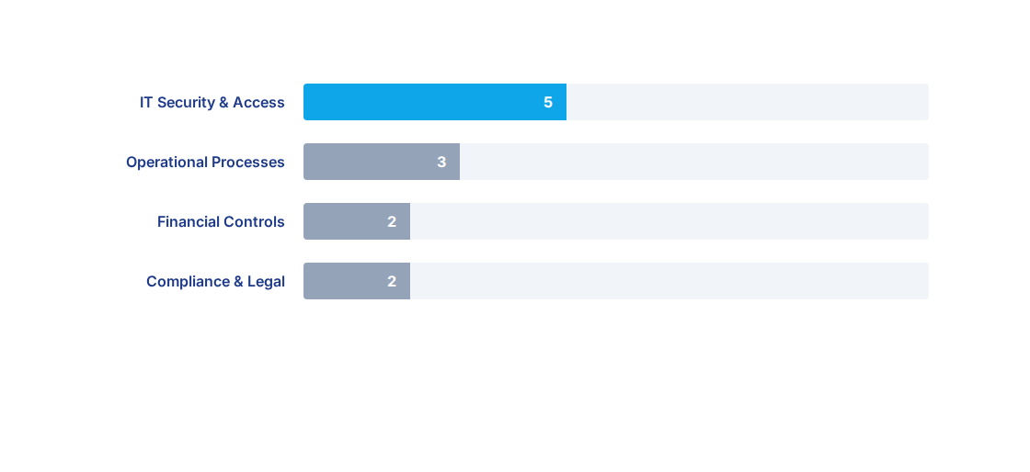
Insights/Exceptions by Process

Slide 9

6. Conclusion & Next Steps
Path Forward to Compliance
The proactive stance taken by executive management to address the IT and vendor management deficiencies highlights a strong organizational commitment to a mature control environment.
Execution: Complete the Q4 remediation plan focusing on automated access de-provisioning protocols.
Validation: Internal Audit to conduct formal validation testing of all remediated controls in January 2027.
Monitoring: Implement continuous monitoring dashboards to track privileged system access req.

